Slide 1
Finance & Auxiliary Services Town Hall
10/3/23

Slide 2
Agenda
Overview of Finance & Auxiliary Services
Staff Experience Survey
Customer Service Initiative
Facility Updates
Other Updates
Department Updates
  Parking & Auxiliary Services (Robert Milner)
  Business Applications Update (Luke Quell)
  HCM System Update (Chiradeep Mukherjee)
  SPAC Transformation(Laura Scarantino)
  What’s New in Change Management & Advisory Services (Michele Evans)
  FY23 Year End Financial Report (Kevin Donegan)
Q&A

Slide 4
Finance &
Auxiliary Services
Organization
G. Scott Bitner
Vice President
Deputy Chief Financial Officer
Systems Implementations Projects
Chiradeep Mukherjee
Executive Director
John Jensen
Assistant Vice President
BUSINESS APPLICATIONS
Luke Quell
Acting Director
AUXILIARY SERVICES
Robert Milner
Executive Director
Office of the VP of Administration and Finance
Lisa Crawley
Office Manager
OFFICE OF THE CONTROLLER
Cynthia Lyons
Assistant Vice President
Controller
STRATEGIC SOURCING & ACQUISITION SERVICES
Keith Gagnon
Assistant Vice President
BUDGET & FINANCIAL ANALYSIS
Kevin Donegan
Assistant Vice President
CHANGE MANAGEMENT & ADVISORY SERVICES
Michele Evans
Assistant Vice President
Accounting & Budget Support
Payroll & HR Support
Procurement Administrative Support
Project & Capital Project Accounting
Parking
Transportation Services
Donaldson Brown
Payroll Services
Student Financial Services
Financial Services
Commodities & Services Procurement
Minority & Small Business Liaison
Warehouse
Mail Services
Budget Reporting
Financial Reporting
Project Reporting
Management Advisory Services
Business & Quality Improvement – Change Management
CENTRAL ADMINISTRATION SUPPORT SERVICES
John Yurich
Director
Sponsored Projects Accounting & Finance
Laura Scarantino
Assistant Vice President
Costing & Compliance
Project Accounting Set Up
Sponsored Billing
Sponsored Collections and Accounts Receivable
Quality Assurance & Reporting
Business Application Support
Training
Notes:
Introduce each AVP / Exec. Director
Ask each member of team to raise hand to come to the forefront of screen

Slide 5
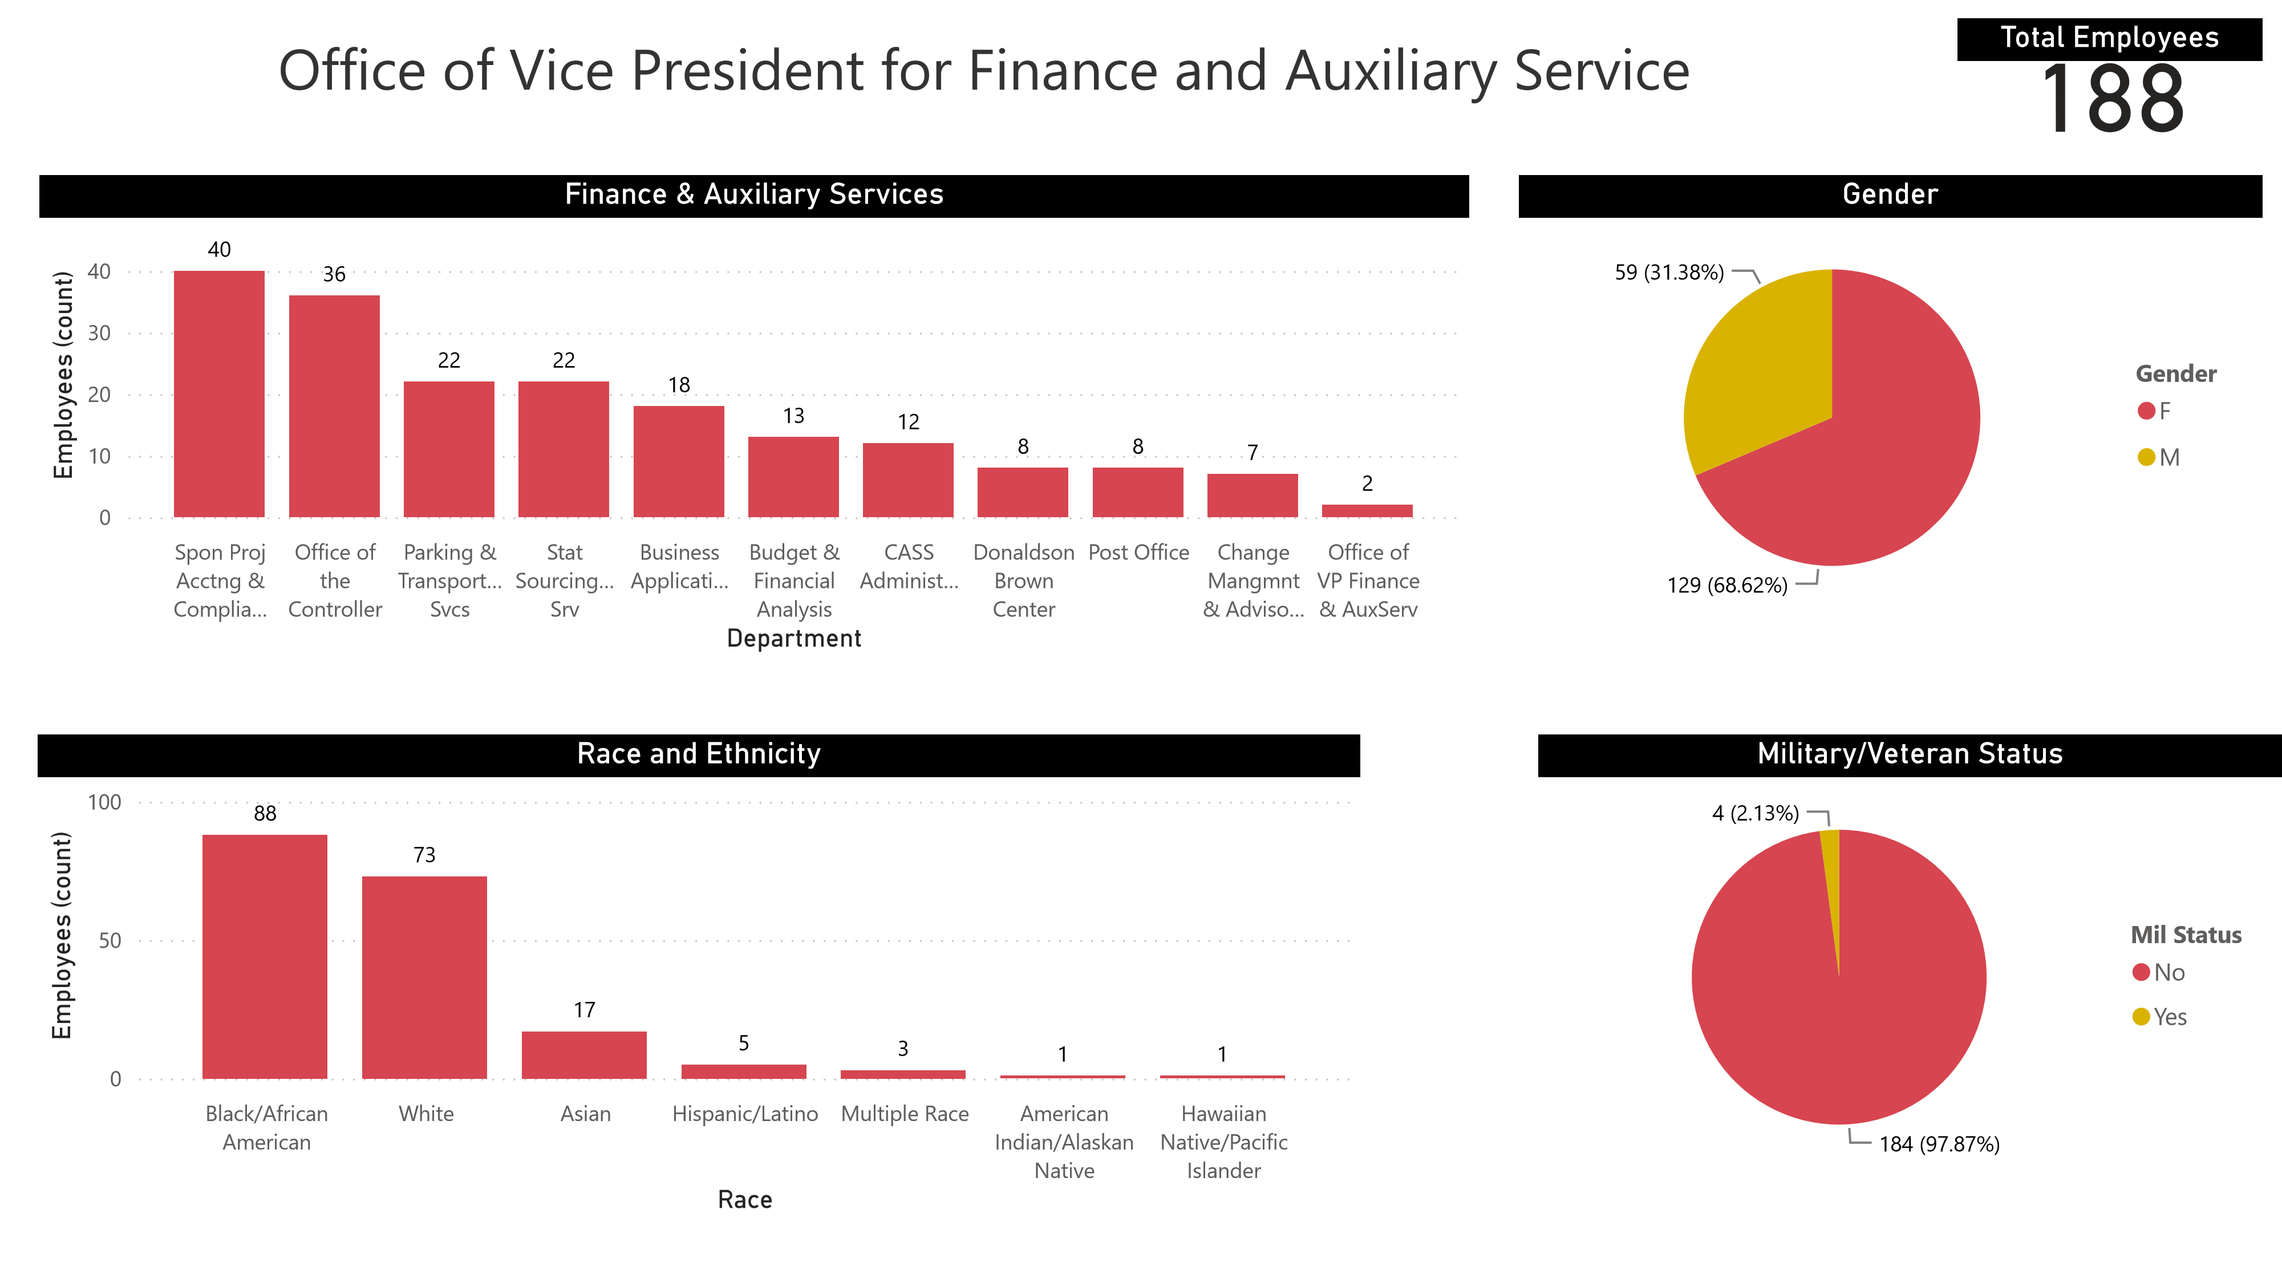
Finance & Auxiliary Services -
Organization
8 departments
188 employees
  68.6% Female
  53.2% Minority
  2% Military / Veteran
Annual budget
  State - $19.3M
  Auxiliary - $10.6M

Slide 6
Accomplishments (July 2022 – current)
Re-Organizations, Expansions:
Merged the Budget Office and Central Administration Support Services Financial Reporting, Project, and Accounting teams
Business Applications separated out from Office of the Controller to expand support of all enterprise business applications (Oracle Financials, SAP Concur, Oracle HCM)
Sponsored Projects Accounting and Compliance restructured to better meet needs of internal and external clients of UMB
Changed Strategic Sourcing and Acquisition Services management structure to have 2 Assistant Directors instead of one Associate Director.
Notes:
D&C: ; previously, projects weren’t managed at the project manager level, requiring other teams – like the plan review team – to be involved. This extended timelines for all projects.
This restructure attempts to reduce the timelines and centralize oversight and accountability for D&C projects. Project Managers now taking leadership for all aspects and all phases of projects

Slide 7
Accomplishments (July 2022 – current)
System Implementations:
Implemented the SAP Concur Travel Expense System
HCM discovery and pre-implementation completed
  Started HCM Implementation (April 2025 Go Live)
Parking Revenue Control Equipment
Parking Permit System
Percipio Learning Management System
EBuilder financial reporting of capital projects

Slide 8
Accomplishments (July 2022 – current)
Initiatives, Programs, or Partnerships:
“Service with Excellence: One Interaction at a Time” (A&F customer service program) finalized, piloted in SSAS
Donaldson Brown: New partnerships with Cecil College and MEDCO
Submitted F&A cost proposal 2 points above the FY16 calculations
Developed a Financial Package to fund the completion of HSF III 5th and 6th Floors
2nd purchase of all-electric service vehicle (Parking and Transportation Services)
Notes:
Recycling Center: BGE must connect the permanent power at the end of April to fully open; have currently achieved temporary occupancy
Deferred Maintenance: GOAL IS TO ALWAYS BE 2 FISCAL YEARS AHEAD WITH IDENTIFYING AND PLANNING:
Projects for FY24 – project list created, procurement contract identified and project design starting (if required for the project)
Projects for FY25- project list created, procurement contract currently getting identified
Projects for FY26- list will be identified in November 2023
Donaldson Brown:
FY23 Significant new partnerships with A&F/UMB – Cecil College and hospitality program
FY23 Significant new partnership with MEDCO to create a renovation plan with costs for the Carriage House for future educational partnerships
F&A Cost Proposal:
Huron confirmed in January that the cost proposal was assigned to someone in Houston. The review typically takes 6 months before coming back with questions and a site visit. Site visit will probably occur sometime in mid- to late-Fall 2023. Then, negotiations will continue from their findings. Anticipate the final negotiated rate at beginning of next calendar year – 2024.

Slide 9
Accomplishments (July 2022 – current)
Operational or Process Achievements:
Reduced Quantum Payroll Processing time from 4-6 hours to 15 minutes
Payroll reduced the delinquent timesheets from campus-wide to just 2 schools
Reduced number of returned payroll related forms from CPB by 43%
Reduced invoice to pay delay rate from 2021 average of 15.76% to 7.76% in 2022
  Implemented additional changes to the processing of PO invoices further reducing the delay rate
  Average over last 4 months is 3.99% with low last month (Aug) of 2.25%
Student Services developed Crystal Reports, secured the student SSN transmission, and improved student billing and payment processing
Notes:
AiM – added 500 buildings to AiM to allow DM projects to be executed + implemented standard AiM training schedule

Slide 10
Accomplishments (July 2022 – current)
Operational or Process Achievements:
General Accounting automated processes / reconciliations and deployed end-user self service tools
Financial Reporting implemented GASB 96 which requires reporting for subscription-based information technology arrangements. This involved discovery, establishing process for record-keeping, and reporting
Implemented multi-year PO functionality to enhance encumbrance reporting and financial planning
Increased reporting capabilities to more easily identify MBE firm at prime award
SPAC collections/receivables >60 days decreased from $33.2M (07/08/22) to $18.8M (09/18/23)
Notes:
AiM – added 500 buildings to AiM to allow DM projects to be executed + implemented standard AiM training schedule

Slide 11
Accomplishments (July 2022 – current)
New Policies:
Business Travel Policy
EV Charging Station Policy
Sponsored Project Accounting & Compliance Policies
  Two approved w/ additional 4 in review cycle
Notes:
Add to slide these two. I think the first one was in the last year.
Business Travel Policy → 2/24/2023
EV Charging Stations Policy – 5/24/22 → would have been after the FY23 Budget Presentation
Emergency Egress Policy → 3/21/2023
Accessing University Buildings Policy → 11/1/2022

Slide 12
Strategic Plan Update
UMB has 302 goals
  A&F has 57 goals
  Finance and Auxiliary Services has 17 goals
Progress is tracked semi-annually by UMB
Internally we status quarterly
More to come
Notes:
Purpose - awareness

Slide 13
Staff Experience Survey
Completed in 2022
Reports issued for Departments w/ > 10 staff
Only CASS and CMAS did not receive a report
All are included in the Finance & Auxiliary Services Report
  Except SPAC which was not consolidated under F&AS
You should/will have access to reports for your department
  Waiting on HR to provide SSAS EDI report
  Finance & Auxiliary Services report will be posted on website
Each department has identified actions plans

Slide 14
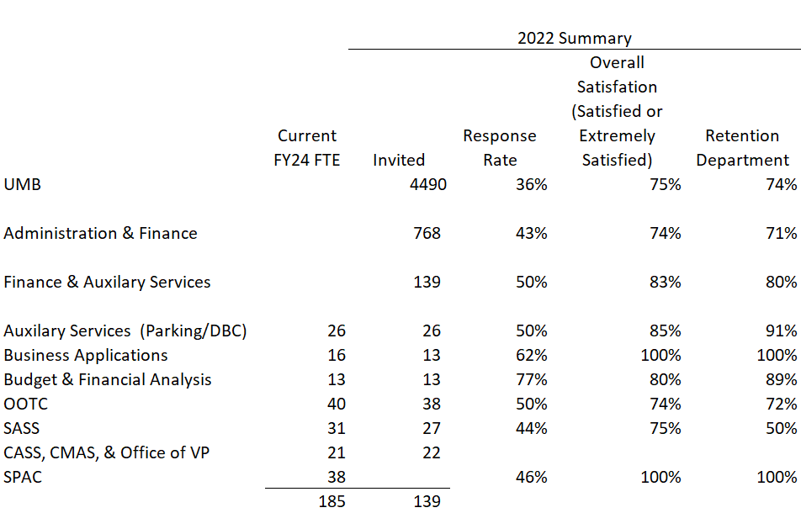
Staff Experience Survey
Participation Summary
SPAC was not included in F&AS report

Slide 15
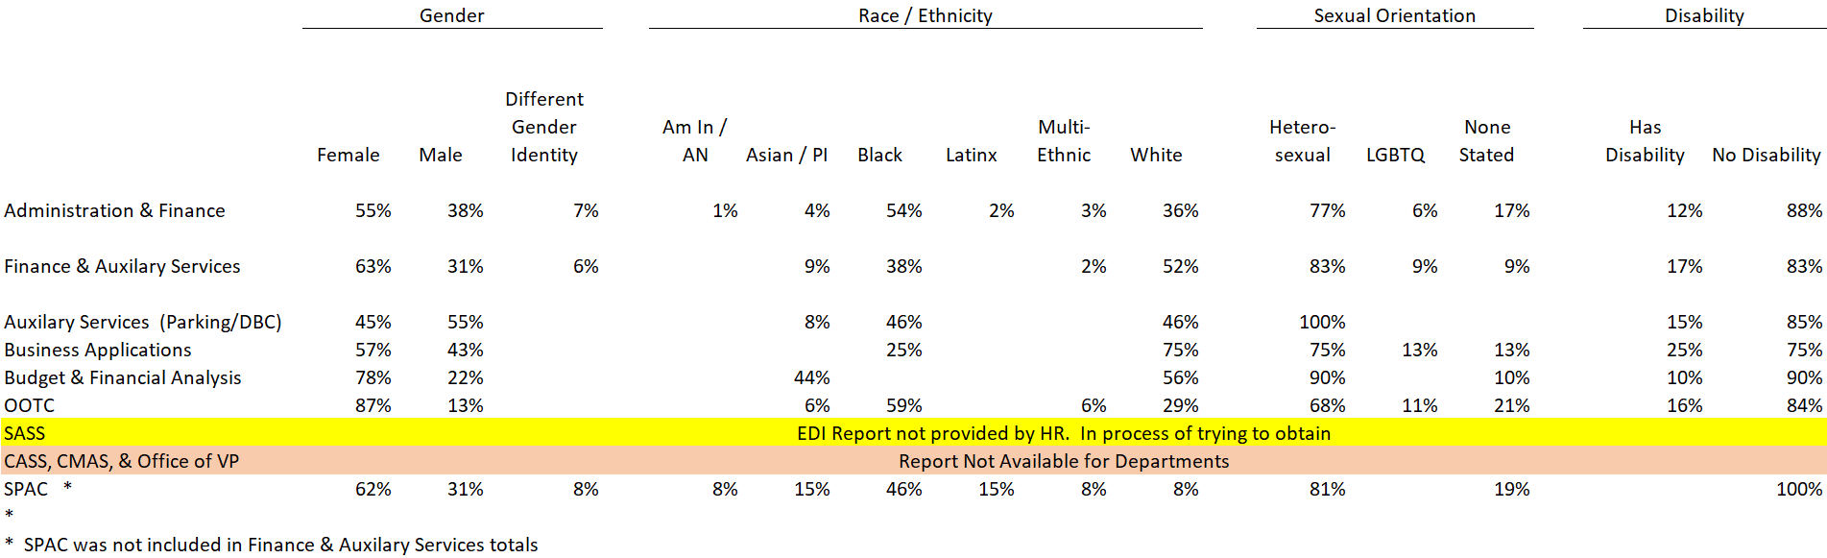
Staff Experience Survey
Participation
EDI Response Summary

Slide 16
EDI Takeaways from Survey
10 EDI ratings under Satisfaction w/ UMB and Diversity and Climate
  Rated as Good (Room for improvement as none were Excellent)
  Rated better than Admin & Finance in all rating categories of EDI
Across ALL 59 survey ratings for organization
  Female (3 Marginal, 46 Good, 10 Excellent)
  Male (5 Marginal, 44 Good, 10 Excellent)
  Asian (10 Good, 49 Excellent)
  Black (10 Marginal, 43 Good, 6 Excellent)
  White (3 Marginal, 42 Good, 14 Excellent)
  Heterosexual (5 Marginal, 44 Good, 10 Excellent)
  LGBTQ (1 Low, 13 Marginal, 37 Good, 8 Excellent)
  No Sexual Orientation Stated (9 Low, 20 Marginal, 26 Good, 4 Excellent)
  Disability (1 Low, 20 Marginal, 33 Good, 5 Excellent)
Report has helped raise awareness within communities of where we need to improve

Slide 17
Finance & Auxiliary Services (all but SPAC)
Staff Experience Survey Satisfaction Scores
Top Scores
Supportive of personal issues
Treats with respect
Enjoy working with coworkers
Know how to use tools
Contribute to departments mission
Lowest Scores
Adequate staffing
Total compensation
Appropriate stress
Campus faculty value
Have a voice
Blue overlap with SPAC. Other SPAC scores (Top – Understand Dept Mission, All Cultures – Fair, Community Excellence – Professional; Lowest – Measures Dept Goals)

Slide 18
Finance & Auxiliary Services (all but SPAC) Staff Experience Survey Drivers of Satisfaction Scores
Influential Strengths
- Integrates core values
Contribute to departments mission
Spirit of cooperation
Recommend without fear
Sufficient freedom
Primary Opportunities
Adequate staffing
Work assigned equitably
Total compensation
Advancement opportunities
Participate in decisions
Blue overlap with SPAC. Other SPAC scores (Strengths - Physical work environment, Evaluate Fairly, Performance Evaluation, Gives Praise for Work, Ethical Conduct; Opportunities – Safe Environment, Appropriate Stress)

Slide 19
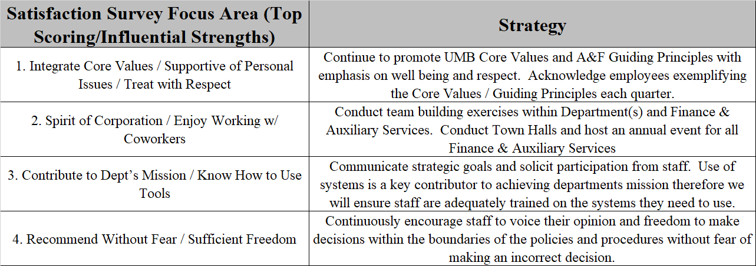
Staff Experience Survey
Strength Action Plan

Slide 20
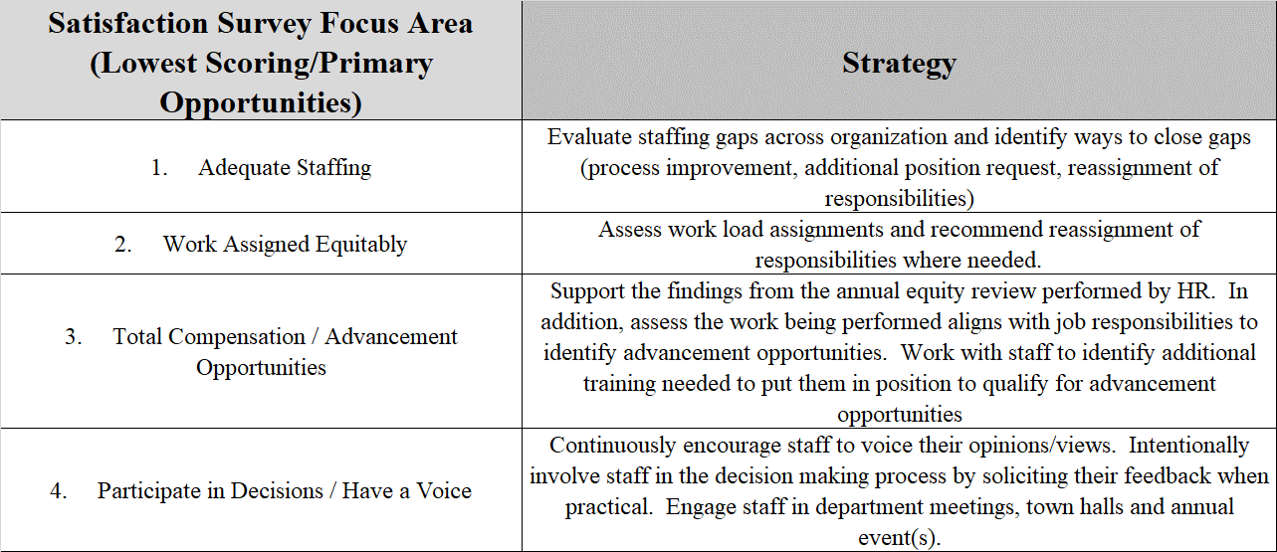
Staff Experience Survey
Opportunity Action Plan

Slide 21
Customer Service Initiative
Aligned with A&F guiding principle:
  Service Excellence: One Interaction at a Time
Seeking to improve the customers experience when interacting with any A&F unit, whether in person, virtually, or by email/phone
Phases
  Phase I: Orientation, Self Assessments, Customer Surveys & Analysis
  Phase II: Training, Coaching & Action Planning
  Phase III: Support and Implementation of Action Plan
  Phase IV: Follow Up / Program Sustainability (12-18 months)
6 months

Slide 22
Customer Service Initiative
SSAS participated in pilot started over summer 2023
11 Cohorts
Timing for other organizations
  Cohort 1 (9/23 – 3/24) includes Business Applications, Budget & Financial Analysis & CMAS
  Cohort 3 (11/23 – 5/24) includes OOTC
  Cohort 5 (1/24 – 7/24) includes CASS
  Cohort 6 (2/24- 8/24) includes SPAC
  Cohort 9 (6/24 – 12/24) includes Auxiliary Services

Slide 23
Benchmarking Study
Requested by Funding Model Workgroup prior to pandemic
Put on hold due to pandemic and implementation of Quantum Financials
Exploring benchmarking options
Would include all administrative functions performed across the campus
Looking to engage and gather data 2023-2024

Slide 24
Facility Updates

Slide 25
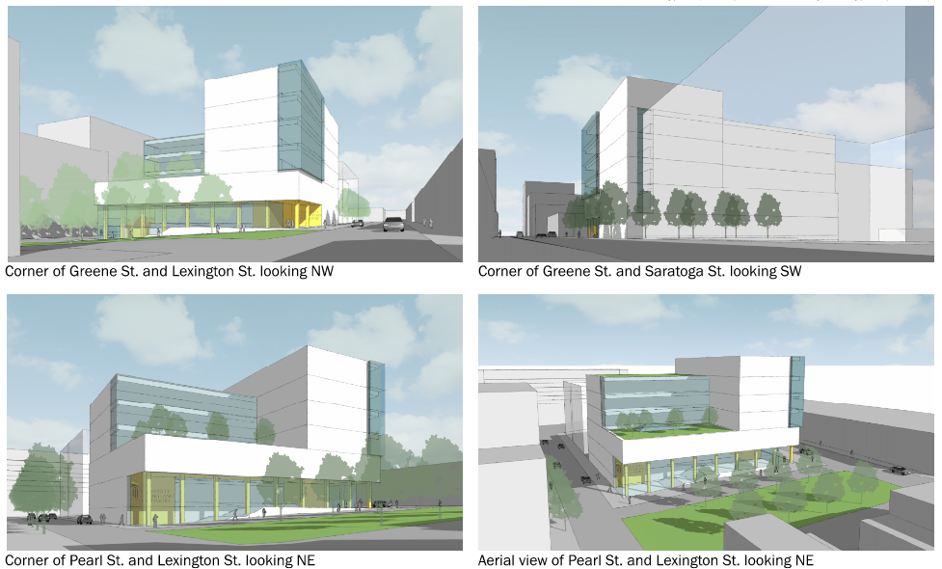
School of Social Work
New Building:
127k GSF
72k NSF
Total
Budget:
$121m
Completion:
Fall 2027

Slide 26
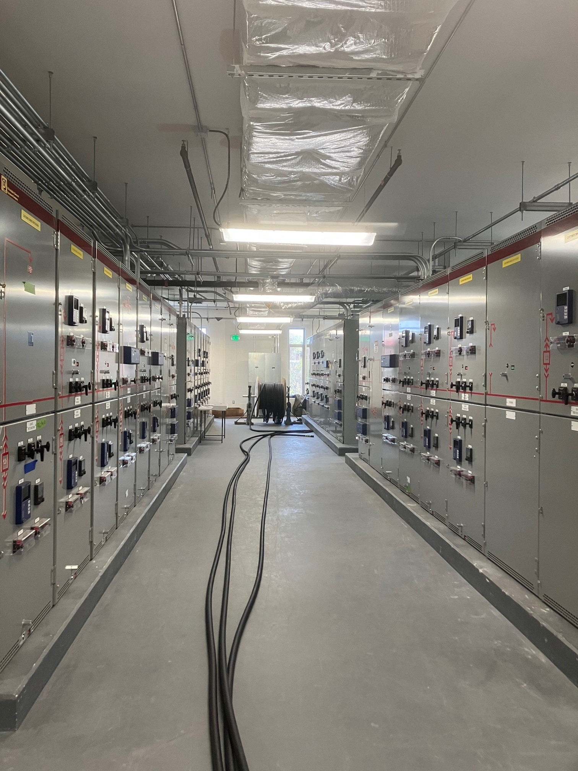
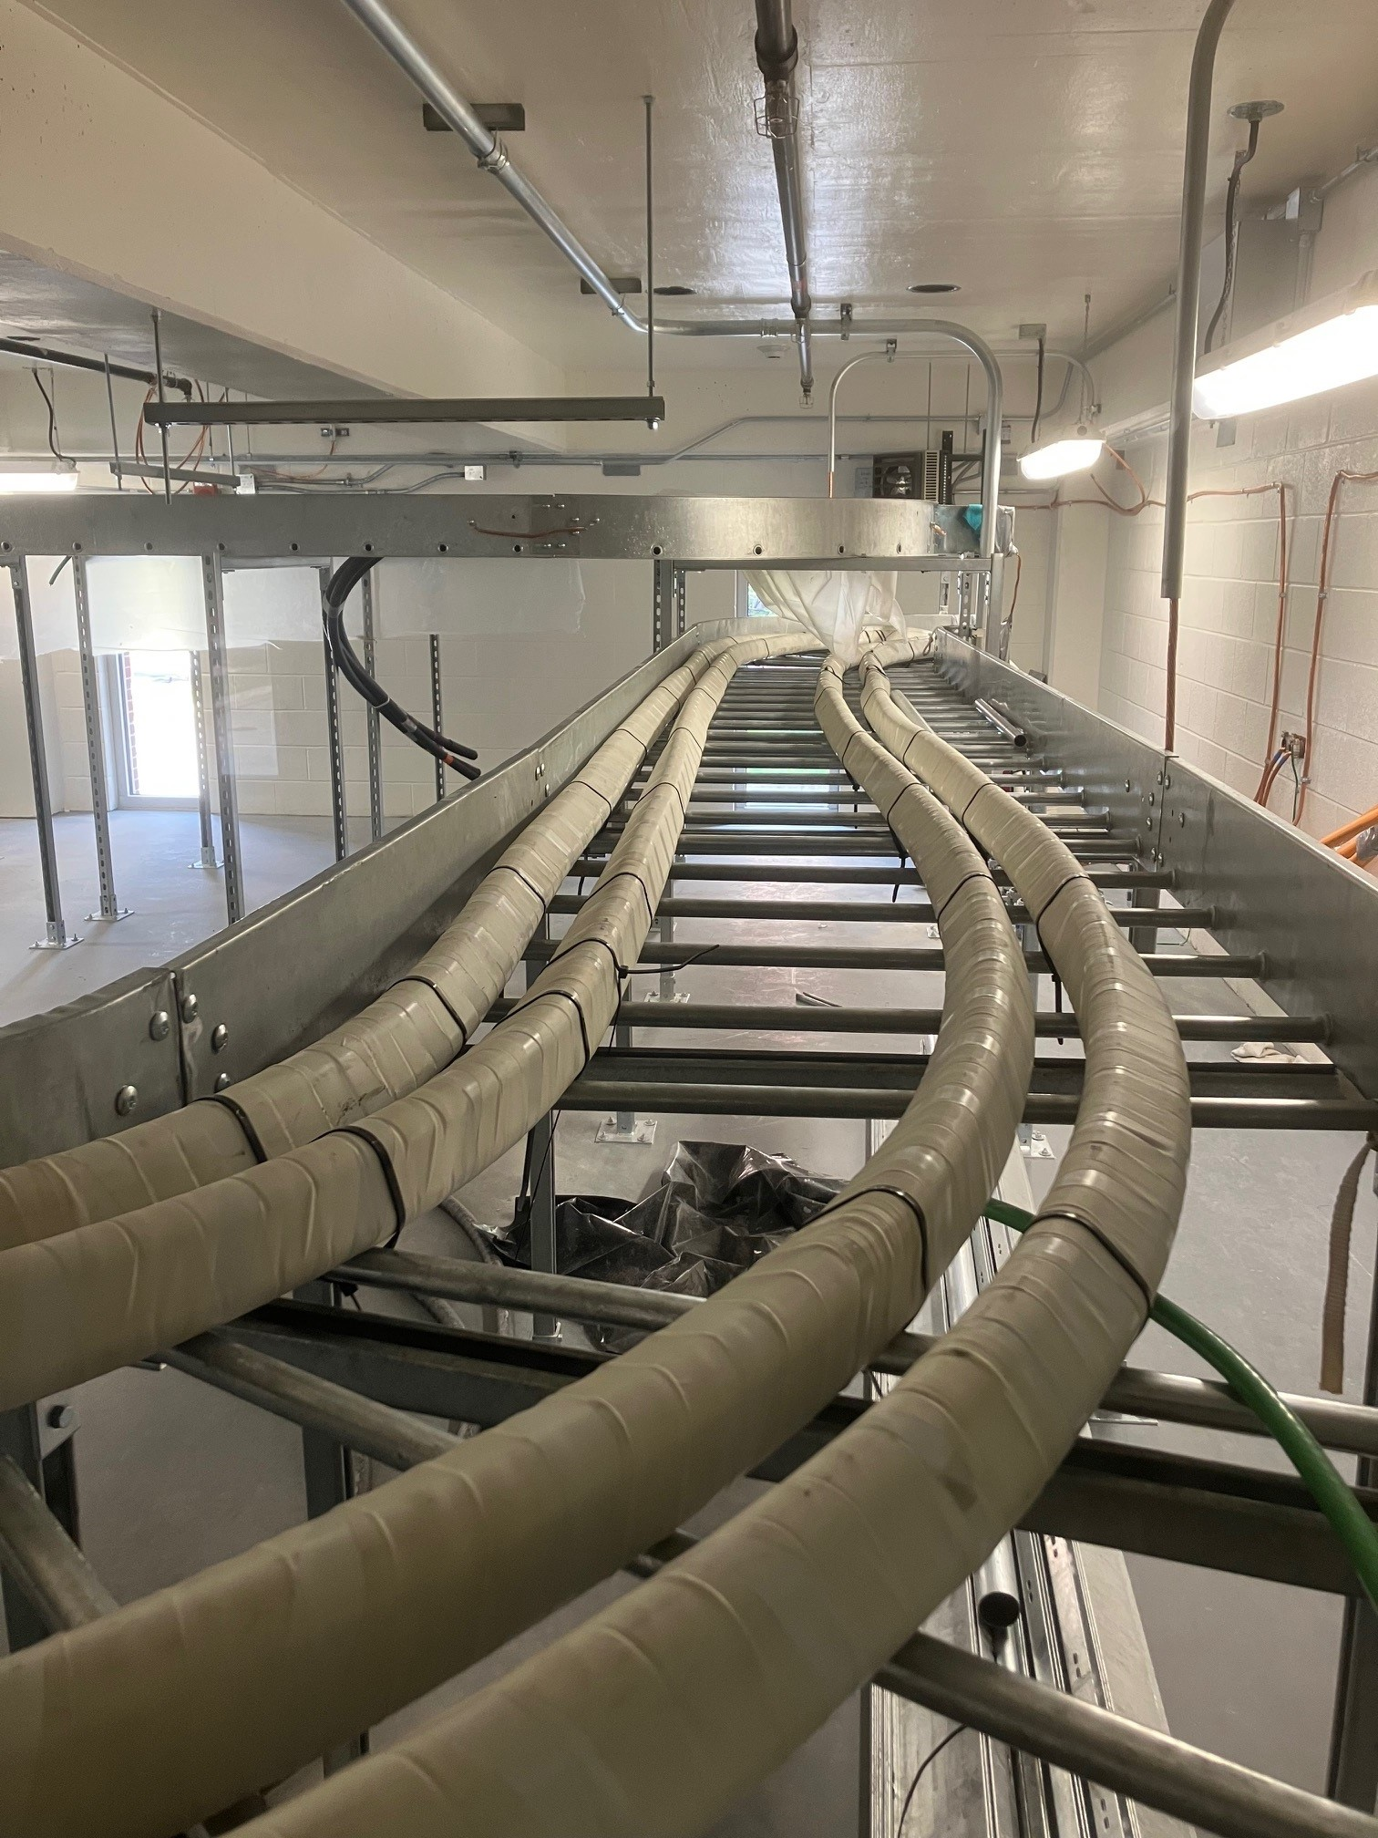
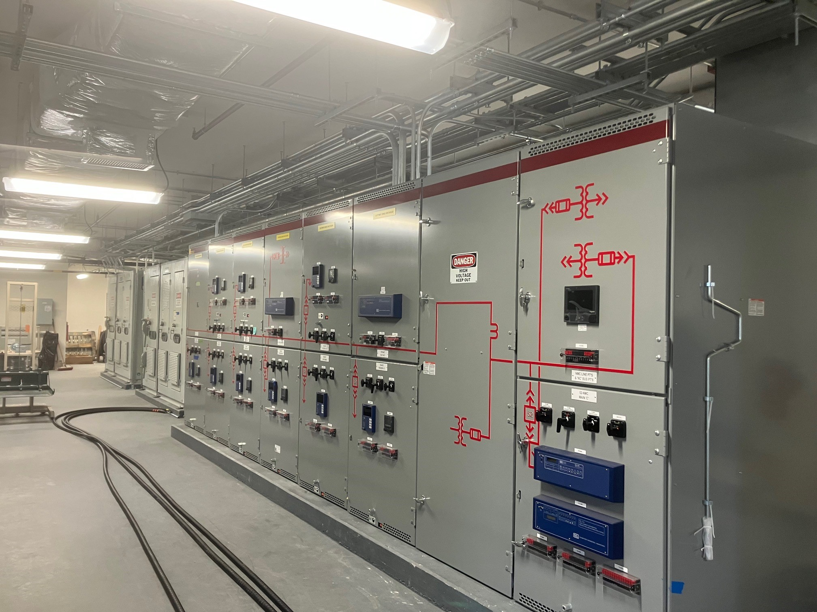
Electrical System
Infrastructure Upgrade
Upgrade of infrastructure and to address redundancy
Eliminate single point of failure
North / South Substations
13 Year project
Expected to be completed in 2027
$85M

Slide 27
University of Maryland 3 - Institute for Health Computing (UM-3-IHC)
UMB partnering with UMCP and UMMS
Located in North Bethesda, MD
Leverage UMMS’s provision of customized unique and diverse de-identified data sets and bring together world-class researchers exploring how artificial intelligence (“AI”), machine learning (“ML”), and clinical analytics can facilitate knowledge discovery for human health and wellbeing
The Institute will be a transformative collaboration between the Montgomery County, UMMS, and the Universities to establish North Bethesda as a national epicenter of computationally enabled biomedical research, population health, and precision medicine.
Starting out in leased space with goal for Montgomery County to build facility
Partnership received a $15M grant from Montgomery County to start program
Federal grant for $3M for computing equipment
Annual funding from Montgomery County of $5M (FY24-FY28)
Annual funding from Mpower of $5M (FY23-FY28)

Slide 28
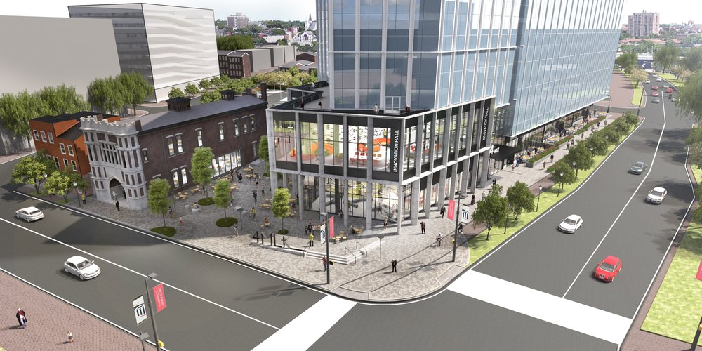
4 MLK Bldg.
Located in BioPark
250K sq. ft.
8 stories
To open September 2025

Slide 29
Other
Mid Year Performance Reviews
  Non-Exempt (Required) due 10/31
  Exempt (Recommended) due 11/30
Employee Discounts
  Lexington Market https://elm.umaryland.edu/announcements/2023/OneCard-Now-Provides-Students-and-Staff-Discounts-at-Lexington-Market.php
  Hippodrome https://www.umaryland.edu/arts/featured-theater-events/hippodrome/

Slide 30
Parking & Auxiliary Services Update
Robert Milner

Slide 31
Parking and Revenue Control Equipment (PARCS)
INSTALLATION
Installed over 500 piece of equipment in all 7 UMB garages
Installation was 7 weeks for 7 UMB garage with limited disruption to campus
Re-permitted 8000 UMB parkers with new AVI Permits
Eliminated paper waste
NEXT STEPS
Re-permit part-time faculty and employee daily with new AVI permits
  Fall 2023
Roll-out cell phone technology
  Fall 2023

Slide 32
USM/MTA Employee Benefit Program
PROGRAM
Transitioned from the MTA Sticker Program to the Charm Mobile App within 15 days
Enrolled over 1000 eligible employees since July 2023
Created an electronic approval process for the collection of alternative State ID process
NEXT STEPS
Monitor and Maintain USM/MTA Employee Benefit Program

Slide 33
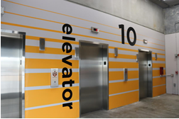
Upcoming Garage Renovations/Restorations
Penn St. Graphics
  Visual enhancements and directional signage
Penn St. Structural Repair
  Concrete decks, coating replacement, T-beam repair
Saratoga Structural Repair
  Sprinkler system replacement and addressing water penetration into elevator lobbies.
Sustainability initiative
  Solar canopy installations on the rooftop of Penn St and Pearl St garages.

Slide 34
Transportation Working Group Committee
Goal - This working committee has been assembled to strategize/identify ways to enhance the transportation experience for UMB students, faculty, and staff by gathering data and conducting research to make recommendations to the senior leadership.
Survey sent to ~15,000 members of UMB
  Participation is a crucial step toward identifying needs for change and areas of success, and feedback will help to enhance the transportation experience for UMB students, faculty, and staff.
  Working Group Members have been assigned various tasks and benchmark gathering of information

Slide 35
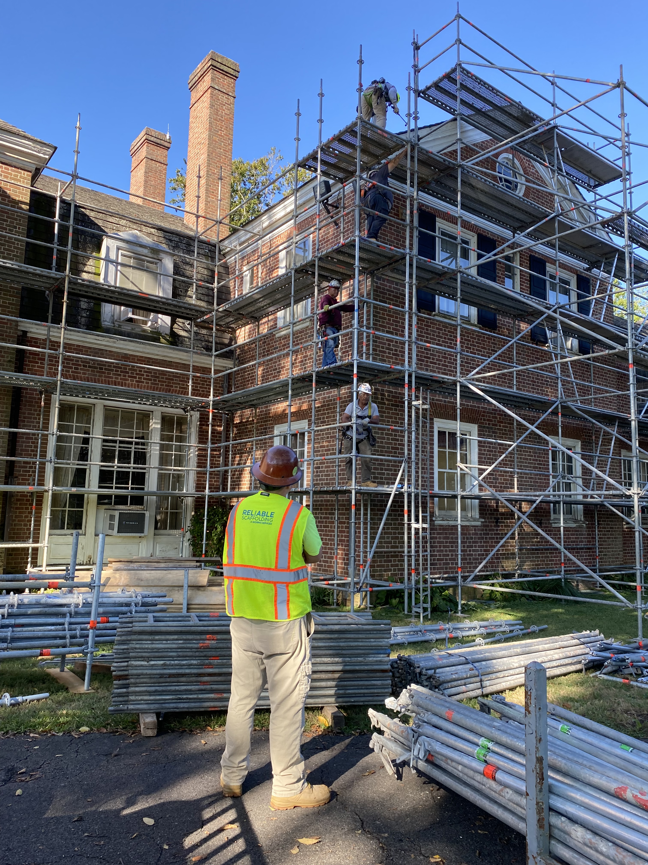
Donaldson Brown Riverfront –
Renovations
Scaffolding being erected
Plans include
  a new roof of environmental and sustainable material
  All windows/doors/shutters restored
  Columns restored
Project should be completed by Spring 2024

Slide 36
Donaldson Brown Riverfront –
Educational Partnership
Working in conjunction with Cecil College, MEDCO, & MD legislature to convert the Carriage House into an education center
Student run facility teaching hospitality, tourism, history, agriculture, horticulture, and related classes
Non-credit course began August 28th at Cecil College with a UMD Master Gardner to install colonial garden at the mansion

Slide 37
Donaldson Brown Riverfront – Thank you
We cannot thank UMB enough for your support
Conferences, training, and retreats
This past year, UMB groups have included Public Safety, the President’s Office, Communications, HSHL Library, A&F, SOM, Health and Homeland Security, Accountability & Compliance
Keep us in mind for your next event

Slide 38
Business Applications Update
Luke Quell, Acting Director BA

Slide 39
What’s New?
23 A, B, and C Enhancement Cycles
Concur Launch
29 new or enhanced Quantum Financials Reports
2,255 people trained across 144 training classes
HCM Implementation Kickoff

Slide 40
SAP Concur Travel &
Expense System
2,734 Requests and 4,736 Expense Reports created
1,953 people trained across 53 classes
24 drop in sessions
7 new reports
Travel Encumbrances – Coming Q1 2024!
Fiori Theme (new look and feel) – Coming Q1 2024!

Slide 41
Quantum Human Capital Management(HCM)
System Update
Chiradeep Mukherjee, Exec. Director BA

Slide 42
Agenda
Project Organization Chart
Benefits of (Cloud) SAAS Environment
Quantum HCM Journey
Scope and Timeline
Q&A

Slide 43
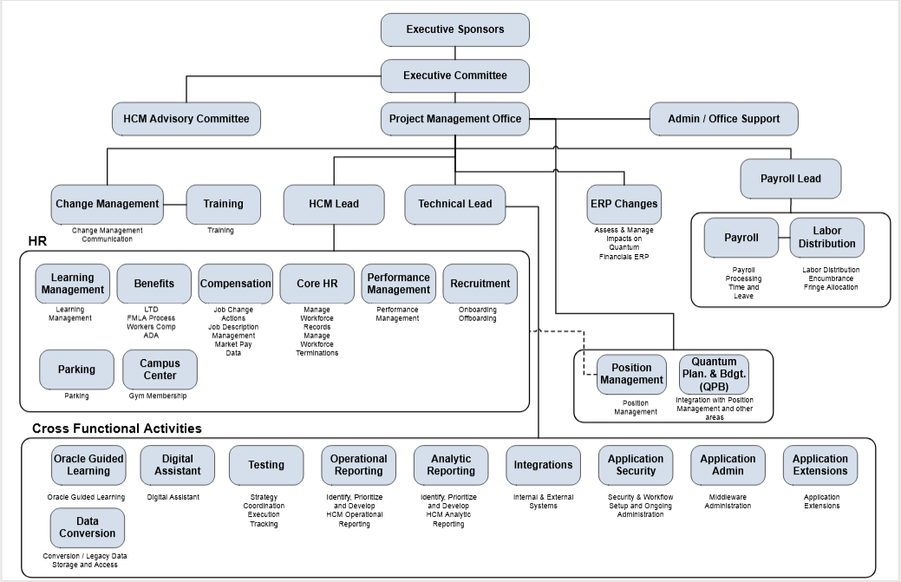
Project Team

Slide 44
Benefits of a (Cloud) SaaS Environment
Places UMB in a better position for the future with consistent updates to functionality and technology.
01
02
Provides users with access to contemporary analytics and reporting functionality.
Benefits of
(Cloud) SaaS
Delivers mobile-friendly access with the system accessible
anytime and anywhere.
03
Includes contemporary security tools for the protection of
sensitive human resources data.
04
Introduces Artificial Intelligence (AI), which will create a
more powerful next-level user experience.
05

Slide 45
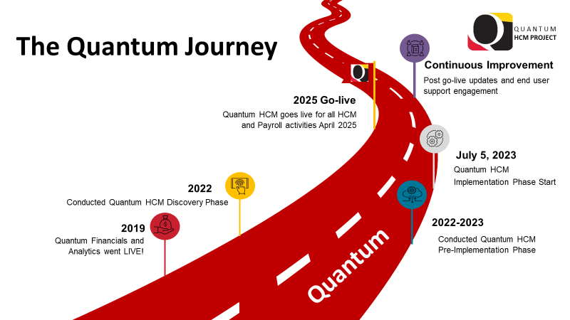

Slide 46
Quantum HCM Project Scope
Recruiting
Compensation
Talent Management
Learning
Onboarding/ Offboarding
Labor Distribution
Core HR
Payroll
Absence
Reporting and Analytics
Position Management
Benefits
Guided Learning
Time and Labor
Position Budgeting
Digital Assistant

Slide 47
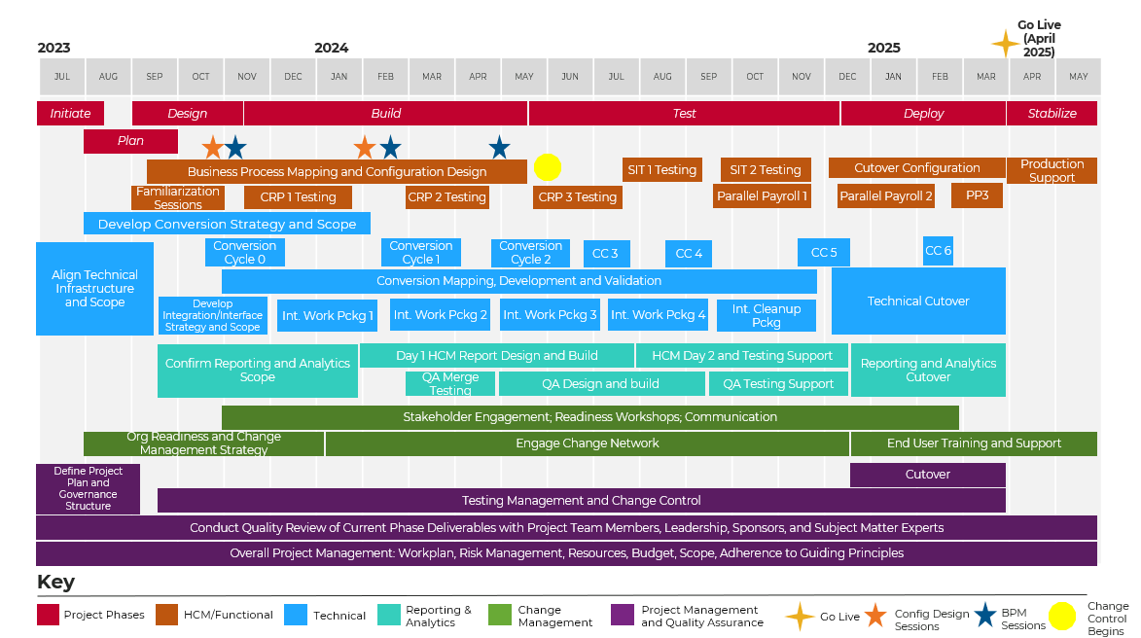
Implementation Project Timeline

Slide 48


Q&A
For more information, please contact:
Stacy Long stacy.long@umaryland.edu
Chiradeep Mukherjee cmukherjee@umaryland.edu

Slide 49
SPAC Transformation
Laura Scarantino, Assist. VP SPAC

Slide 50
The Steps to Reorganization
Start with your departmental strategy based on Organization Vision, Mission, Guiding Principles
Identify strengths and weaknesses in the current departmental organizational structure
Consider your options and design a new structure with your team
Communicate the reorganization plan internally and externally
Launch your departmental restructure
Adjust as necessary

Slide 51



Until October 21, 2022
Central Team (6) + M
Team Red (4) + M
Team White (4) + M
Team Shared Services (6) + M
  Team Blue
  Team Green
  Contract Team
Functional
Cost Team (2.5) + M

Slide 52
Identified Challenges
Communication
  10 email boxes attached to workflows
  Depts & Teams kept copying multiple boxes
Not easy training soup to nuts
  We have over 1K sponsors
  We have almost 3K active awards
Did not have time or resources after Quantum implementation to effectively align processes

Slide 53
SPAC
WHAT
Functions Do we perform?
Setup Projects
Bill Non-Federal Projects
Bill Volume/Milestone/Schedule
Bill Fed award (not LOC)
Federal Financial Reporting (LOC) & Quality Assurance
Collections & Accounts Receivable
Cost Analysis & Compliance

Slide 54

SPAC
It develops effective communication within a department
Members of a silo know exactly what work you are undertaking
Helps identify improvements required and the resources needed
It fosters a community of individuals that will look out for each other
The end goal is to improve the department as a whole.
High Volume Departments

Slide 55


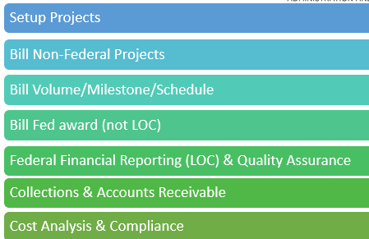
TRANSLATES TO SPAC TEAMS TODAY
What SPAC does
SETUP TEAM
BILLING TEAM
Nonfed
Fed
Volume/Milestone/Sched
QUALITY ASSURANCE TEAM
COLLLECTIONS & A/R (CAR) TEAM
COST ANALYSIS & COMPLIANCE

Slide 56
Communication is Key
Understand Your Objectives.
Be clear about your overall communication objectives.
Understand Your Audiences. Now identify and list your different audiences. Choose the Right Channels.
Planning Your Message.
Monitor Effectiveness.

Slide 57


Challenges
Successes
Departments still send multiple workflow emails
Some Workflow issues (resolved)
Coordination & communication
SPAC teams still overwhelmed
Exposed development needs
Allowed us to start training
Added 6 more staff
More collaboration in department
Clearer path to needed resources

Slide 58


Slide 59
What’s New in Change Management & Advisory Services
Michele Evans, Assistant Vice President

Slide 60
Change Management and Advisory Services
CMAS
Management Advisory Services (MAS)
Organizational Change Management (OCM)
Since 2010
Advising, Assisting, Educating
Audit, Compliance, Internal Controls
Proactive – Opportunities for Improvement
Promote Collaboration
Business Process, Policies/ Procedures
Since 2020
People Side of Change
Current State to Future State
Adopt and Embrace
Benefit Realization
Business Process Improvement
Jen Thompson Director
Elaine Portnoy
Manager
Chris Manoto
Cheryl Fuller
Analysts
Beth Gallico
Senior Analyst
Christina Way
Senior Analyst
Vacant
Analyst
mas-help@umaryland.edu
dl-bf-cmas@umaryland.edu
Notes:
CMAS is made up of MAS and OCM.
MAS was created in 2010 – focus is on advising, assisting, and educating on topics such as audits, compliance, internal controls, business processes/procedures.
In addition to coordinating auditors work on campus and responding to audit reports, MAS proactively looks for opportunities for improvement and promotes collaboration between central administrative offices and schools/depts.
Team members and email for help.
OCM was created in 2020 – focus is on the people side of change and helping to move individuals through changes from their current state to the desired future state. Change happens in many different ways, but always requires individuals to choose to participate in the change. Through proven change management tools and assessments, employees are prepared to adopt and embrace the change which will lead to realization of the benefits of the change and business process improvements.
Team members and email for help.

Slide 61
Organizational Change Management (OCM)
Project Managers, Executive Sponsors
Prosci®
Change Management Methodology – Certified Practitioners
Training
Certification – 3-day
Other – Role-based
Partner
Change Management Network
Structured Approach, Tools, Assessments
Notes:
Today’s focus is just on OCM – the newer part of our organization.
OCM partners with project managers and executive sponsors on specific project related changes (e.g., Quantum Financials, Quantum HCM). Beth is assigned to the QHCM project full time until go-live in 2025. The Change Management Network are other OCM partners. CMN is made up of representatives with expertise in the specific subject areas from across UMB – designed to promote university-wide collaboration and input, information sharing, mechanism for feedback and exchange of new ideas/requests.
OCM follows the Prosci change management methodology. Our team are Prosci certified change practitioners. Prosci methodology uses a structured approach with standard tools and assessments (e.g., ADKAR Model, stakeholder assessments).
Prosci offered training – Those who have attended so far – 3-day practitioner certification program. Prosci provided us with information on other role-based sessions that are available.

Slide 62
Role-Based Training Options
Who has already attended?
Two cohorts – UMB specific sessions – Oct 2022 and Mar 2023
32 attendees – 25 from A&F - 11 from FAS
Certified Change Practitioners – access to Prosci® toolset for one year
Practitioner Program – certification, 3-day
Sponsor Briefing – senior leaders who sponsor change
Delivering Project Results – project managers/team
Leading Your Team Through Change – supervisors/managers of employees who will experience change
Employee Orientation – employees impacted by change
Taking Charge of Change – anyone who needs a better understanding of change management
Interested?
Reach out to Christina Way cway@umaryland.edu
Notes:
OCM has organized two cohorts in the past year.
In addition to the Practitioner Program – these are the other role-based sessions offered by Prosci.
If you are interested, reach out to Christina with your contact information and which session(s) you want to know more about. She will coordinate with Prosci to get more details (dates/cost/etc). If there is enough interest for another UMB specific session, we can put together another cohort.

Slide 63
FY’23 Year End Financial Report
Kevin Donegan, Assist. VP BFA

Slide 64
Agenda
FY’23 All Funds Actuals
FY’23 Fund Balance Growth Performance
Tuition & Fees
Enrollment
Grants & Contracts
  Proposal Activity
  Awards
  Spending and Indirect Cost Recovery

Slide 65
FY’23 All Funds Actuals
Unrestricted ($M)

Slide 66
FY’23 All Funds Actuals
Restricted/Total ($M)

Slide 67
FY’23 Net Unrestricted Activity
Notes:
Includes Plant Funds

Slide 68
FY’23 Fund Balance Goal ($M)

Slide 69
FY’23 Net Tuition & Fees ($M)

Slide 70
Enrollment by
School and Program
Notes:
** Shady Grove Fall 2023 won’t be available until first week of October
Fall 2022 v. 2023
Total Schools difference -178
Significances
+49 Medical: MS Medicine -9, Certificate +1, MPH +2, DPT +3, MCG+3, MD +5, DMSc +8, BS +8, PhD +9, MS Physician Asst +19
+46 Graduate (Unaffiliated): PhD +4, Certificate +14, MS +28
-147 Pharmacy: PharmD -27, MS -156, Certificate +9, PhD +27
-69 Social Work: MSW -69, PhD +0
-46 Nursing: MSN -34, DNP -31, MS -10, PhD -3, Certificates +1, BSN +31
Insignificances
-1 Dental: BS -3, Certificate -2, MS -1, DDS +2, PhD +3
-10 Law: MSL -14, JD (Day) -1, JD (Evening) -1, LLM +6
Total Graduate School -57
-120 Grad Pharmacy: MS -156, Certificates +9, PhD +27
-13 Grad Nursing: MS -10, PhD -3
0 Grad Social Work: PhD 0
+2 Grad Dentistry: MS-1, PhD +3
+9 Grad Medical: MS -9, PhD +9, Certificate +1, DMSc +8
+65 Graduate: MS Grad -46, PhD +4, Certificates +14, MS Phys Asst +93
Fully Online Program +1
-42 School of Nursing: Master of Science in Nursing -26, Bachelor of Science in Nursing -16
-14 School of Law: Masters -14
+12 Graduate School: (Grad: Pharmacy) Master -8, Certificate +9, and Doctor of Philosophy +13. (Unaffiliated) Masters +2 and Certificate +5. (Grad: Nursing) Master of Science -9.
+14 School of Medicine: Certificate +14
+31 School of SW: MS +31
University at Shady Grove ???????
Graduate School: Med Cannabis Sci & Therapeutics-56
School of Nursing: Other Nursing (Baltimore) -73, Special Nursing/Other -1, RN-BSN -1, DNP: +2, BSN +45,
School of SW: MSW -23
School of Pharmacy: Pharm D -1
Clinical Dental Hygiene Leader +2
Fall 2021 v. 2022
Total Schools difference -313
Significances
-128 Pharmacy: PharmD -70, MS -62, Certificates -4, PhD +8
-109 Social Work: MSW -105, PhD -4
-55 Nursing: MSN -42, MS -34, DNP -13, Certificates -1, PhD +1, BSN +34
-34 Law: MSL -22, JD (Day) -12, LLM -2, JD (Evening) +2
Insignificances
+15 Graduate (Unaffiliated): MS +27 , PhD +1, Certificate -13
+1 Dental: Certificate +5, DDS -1, PhD -3
-3 Medical: MS +7, DPT +5, MCG+2, PhD +3, MPH -1, BS -1, Certificate -3, MD -15 (*Physician Asst - Split out was not a part of Fall 2022 Enrollment, only in Fall 2023.)
Total Graduate School -76
-58 Grad Pharmacy: MS -62, Certificates -4, PhD +8
-33 Grad Nursing: MS -34, PhD +1
-4 Grad Social Work: PhD -4
-3 Grad Dentistry: PhD -3
+7 Grad Medical: MS +7, PhD +3, Certificate -3
+15 Graduate: MS +27, PhD +1, Certificates -13
Fully Online Program -146
-128 Graduate School: (Grad: Pharmacy) Certificate -64, Doctor of Philosophy +22, and Master +38. (Unaffiliated) Masters -83 and Certificate -14. (Grad: Nursing) Master of Science -27.
-24 School of Law: Masters -24
+6 School of Nursing: Bachelor of Science in Nursing +25, Master of Science in Nursing -19
University at Shady Grove -106
-56 Graduate School: Med Cannabis Sci & Therapeutics-56
-28 School of Nursing: Other Nursing (Baltimore) -73, Special Nursing/Other -1, RN-BSN -1, DNP: +2, BSN +45,
-23 School of SSW: MSW -23
-1 School of Pharmacy: Pharm D -1
+2 Clinical Dental Hygiene Leader +2
Fall 2021 vs Spring 2022
(Total -227)
Pharmacy (-66) decrease. MS-29, PharmD -23, PhD -9, Certificate -5
SOM (-61) decrease. PhD -20, MD -16, MPH -16, MS -4, Certificate -4, Medical & Research Tech BS -1, MCG -1, DPT +1
Nursing (-51) decrease. MSN -16, MS -15, DNP -15, Certificate -4, PhD -2, BSN+1
Graduate School Unaffiliated (-33) decrease. MS -18, Certificate -14, PhD -1
Law (-24) decrease. Day JD -13, MSL -9, LLM -2
Dentistry (-4) decrease. PhD -3, DDS -1, BS-1, MS +1
Social Work +12 increase. PhD -3, MSW +15
TOTAL GRADUATE School (-126) (Pharmacy) MS -29, PhD -9, Certificate -5
(Medicine) PhD -20, MS -4, Certificate -4
Graduate MS -18, Graduate Certificate -14, PhD -1
(Nursing) MS -15, PhD -2
(Social Work) PhD -3
(Dentistry) PhD -3, MS +1
ONLINE PROGRAM (-28) (Grad School - Pharmacy) Certificate -65, Doctorate +10, MS +54
(Grad Unaffiliated) Certificate -12, Masters -5
(Grad School – Nursing) MS -9
(Nursing) MS in Nursing -5
(Law) MS +4
USG (-53) (Nursing) Other Nursing (Baltimore) -44, DNP -3, RN-BSN -1, BSN +14
(Social Work) MSW +8
(Graduate School) Med Cannabis -21, Pharmaceutical Sciences -12
(Pharmacy) PharmD -1
Clinical Dental Hygiene Leader +7
Spring 2021 vs Spring 2022
Total -70
Social Work (-87) decrease. MSW -87
Nursing (-56) decrease. MS -61, BSN -9, DNP -7, Certificate Nursing -6, PhD -2, MSN +29
Medicine (-31) decrease. MD -23, MS -9, Medical & Research Technology BS -3, Certificate -3 Genetic Counseling MGC -2, MPH -1, PhD +3, DPT +7
Dental (-5) decrease. PhD -7, Dental Hygiene BS -1, Dentistry Post Graduate -1, DDS +2, MS +2
Graduate School Unaffiliated (-5) decrease. Certificate -13, PhD +6, MS+2
Law +57 increase. LLM -1, MSL +1, Night JD +10, Day JD +47
Pharmacy +57 increase. PharmD -53, Certificate -3, PhD +10 MS+103
TOTAL GRADUATE School +28 (Nursing) MS -61, PhD -2
(Medicine) MS -9, Certificate -3, PhD +3
Graduate Certificate -13, Graduate MS +2, Graduate PhD +6
(Dentistry) PhD -7, MS +2
(Pharmacy) Certificate -3, PhD +10, MS +103
ONLINE PROGRAM +45 (Grad School – Nursing) MS -49
(Grad School - Pharmacy) Certificate -3, Doctorate +10, MS +15
(Grad Unaffiliated) Certificate -12, MS -3
(Law) MS +15
(Nursing) MS +28, BS in Nursing +44
USG -6 (Nursing) Other Nursing (Baltimore) -62, Special Nursing -7, RN-BSN -4, DNP +6, BSN +31
(Pharmacy) PharmD -28
(Social Work) MSW -27
Clinical Dental Hygiene Leader +13
(Graduate School) Pharmaceutical Sciences +10, Med Cannabis +62

Slide 71
Proposals (Count) by Sponsor Types
FY 2019 - 2023
Notes:
FY23 vs. FY22
State +14% (+28 Counts)
Fed Non-NIH +27% (+48 counts)
Hospital +29% (+20 counts)
NIH -2% (-16 counts)
Foundation -8% (-33 counts)
University -2% (-8 counts)
Corporation -1% (-4 counts)
Other Government +23% (+3 counts)
-----------------------------------------------------

Slide 72
Proposals (Count)
Other Schools
FY 2019 - 2023
Notes:
Other schools except SOM had an increase of 5% in proposal counts. Greatest increase from SOP 21 counts or 15%, SON 20 counts or 29%, SOL decreased 20 counts or 28%
Law: -28% (-20)
Nursing: +29% (+20)
Central Campus: 44% (+7)
Dentistry: -2% (-2)
Social Work: -1% (-1)
Pharmacy: +15% (-21)
Grad School: +23% (+7)

Slide 73
Proposals (in $) by Sponsor Types
FY 2019 - 2023
SOM: FY22 1,648 vs. FY23 1,672 (1.4% increase)
Notes:
Proposals were up 7.5% comparing to FY22
FY22 v. FY23
Federal Non-NIH: +106M or 52%
Other Gov’t: +1M or 30%
State: +10M or 12%
Foundation/Association: +$11M or +8%
Corporation: +1M or +2%
NIH: +9M or +1%
University: +7M or +5%
Hospital: Flat

Slide 74
Proposal Volumes (in $)
Other Schools
Notes:
Other Schools – proposal comparison
Other schools had a 42% increase in proposal submissions with the biggest increases in Pharmacy 86m or 117% and Social Work 54m or 130%

Slide 75
Grants & Contracts Awards (in $) by Sponsor Types
FY 2019 - 2023
Notes:
Federal Non-NIH: +1m or 1%
Foundation: -4M or -9%
Corporation: +9M or +15%
Other Government: increase -3M or -61%
University: -1M or -3%
Hospital: -7M or -46% ($13m from COVID Testing Project)
NIH: -6M or -3%
State: +8M or +8%
---------------------------------------------------------------
Examples:
Federal Non-NIH Sponsors
Centers for Disease Control and Prevention
Department of Defense (DOD)
Department of Health/Human Services
US Department of Education
Other Government Sponsors
Indiana Division of Mental Health and Addiction
Higher Education Commission of Pakistan
Tennessee Dept of Mental Health & Substance Abuse Services
Utah Department of Human Services

Slide 76
Grants & Contracts Awards (in $)
Other Schools
FY 2019 - 2023
Notes:
By School
Admin decrease -$0.5M or -13%
SON +2M or +18%
SOL -0.7M or -9%
SOD +0.7M or +4
GRAD -0.8M or -27%
SOP -1.6M or -4%
SSW -19M or -38%

Slide 77
Total UMB Awards
(Including VA, Foundation & Other sources)
FY 2019 - 2023
Notes:
VA Funding +9% or +1.4M
UMB Foundation +16% or +6M
UMB Awards -0.6% or -3.5M

Slide 78
Grants & Contracts
Spending and Indirect Cost Recovery ($M)
w/o COVID Testing Project
w/ COVID Testing Project
Notes:
w/o COVID Testing Project
+Direct spending decreased 0.8% or $3.5M but Indirect increased 3% or $3M over FY22 (increase mostly from non-federal awards $1m or 35% from foundation/association, 30% or 0.9m from University awards, 24% or 0.7m from State awards )
+Yield increased to 26.1% vs. 25.2% comparing to last couple years
w/ COVID Testing Project
+Covid project ended in FY23, only around $100k of remaining IDC collected for COVID Testing in FY23.

Slide 79
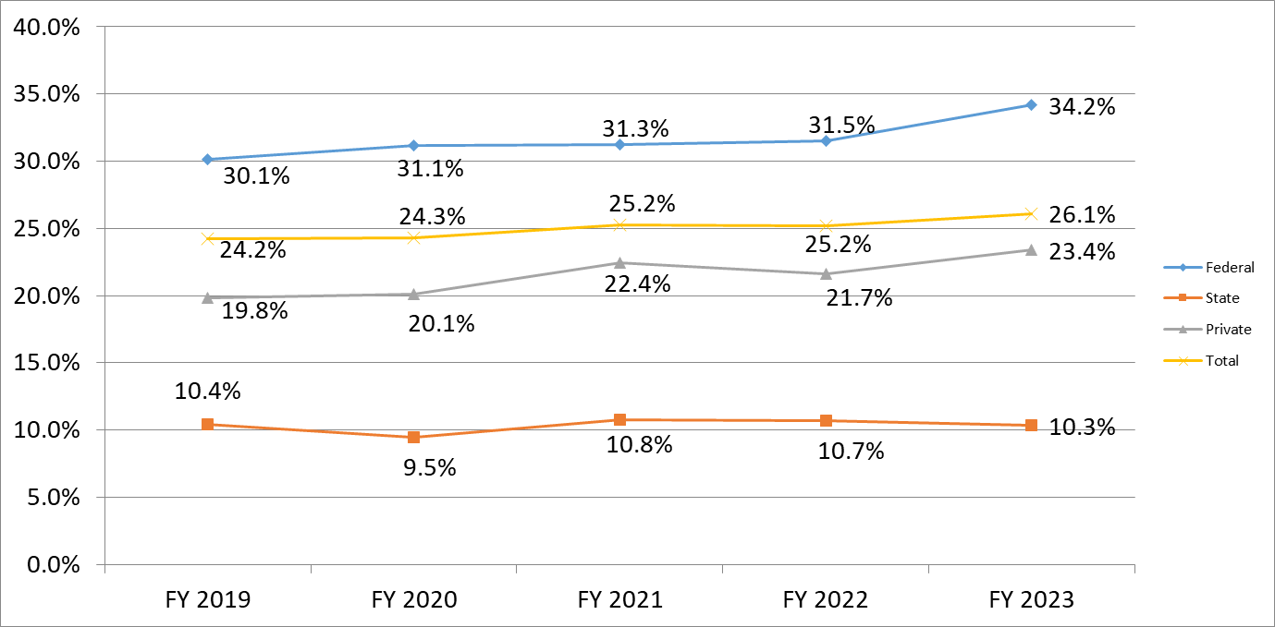
Indirect Cost Yield
(Indirect/Direct) w/o COVID Testing Project
Notes:
+Yield increased to 26.1% vs. 25.2% from FY22 without COVID Testing project
F&A Rates have not changed since 2018.
Higher F&A rate doesn't guarantee higher yield as the yield is calculated based on Direct Costs. So, depending on if DC are allowable for F&A or not (F&A is not applied to all costs).

Slide 80
Questions?

