Slide 1
INTERNAL CONTROL at UMB
Presented by:
Management Advisory Services
www.mas.umaryland.edu
Notes:
WELCOME AND INTRODUCTION
See Title Page in Word for first page of the Presentation

Slide 2
Session Objectives
What is internal control?
  Definition
  Components
Who is responsible?
Why are internal controls important?
What can you do?
What are others doing?
Where can you get help?

Slide 3
Examples of what can happen without adequate internal controls
  Baltimore Woman Accused Of Stealing Thousands From United Way
  GaTech PCard Fraud Video

Slide 4
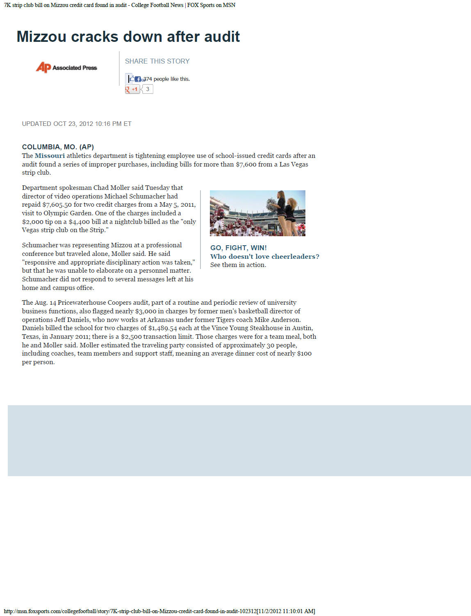
Examples of what can happen without adequate internal controls
The Missouri athletics department is tightening employee use of school-issued credit cards after an audit found a series of improper purchases, including bills for more than $7,600 from a Las Vegas strip club.
One of the charges included a $2,000 tip on a $4,400 bill at a nightclub billed as the "only Vegas strip club on the Strip."
…also flagged nearly $3,000 in charges … two charges of $1,489.54 each at the Vince Young Steakhouse in Austin, Texas, in January 2011; there is a $2,500 transaction limit. Those charges were for a team meal, … an average dinner cost of nearly $100 per person.
4

Slide 5
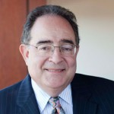
UMB’s Tone at the Top
5

Slide 6
What Is Internal Control?
Internal control is a process, effected by an entity’s management and other personnel, designed to provide reasonable assurance regarding the achievement of objectives in the following categories:
  Effectiveness and efficiency of operations;
  Reliability of financial reporting; and
  Compliance with applicable laws and regulations.
Source: COSO Internal Control Integrated Framework

Slide 7
What Is Internal Control?
Definition (continued):
  It is a process – ongoing, changing, a means to an end – not an end in itself.
  It is effected by people functioning at all levels of an organization – not just policy and procedure manuals.
  It provides management with reasonable assurance – not an absolute guarantee – that objectives are being achieved.
  It focuses on achievement of objectives in several overlapping categories.

Slide 8
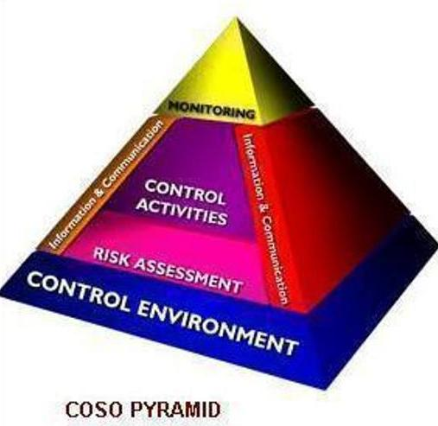
What is Internal Control?
8

Slide 9
What is Internal Control?
Components:
  Control Environment – foundation; integrity; ethical values; competence; accountability; the atmosphere in which you work.
  Risk Assessment – set objectives; be aware of risks; establish integrated methods to analyze and manage risks across the organization; ERM project.
  Control Activities – policies; procedures; segregation of duties; reconciliations; verifications; approval signatures.

Slide 10
What is Internal Control?
  Information and Communication – systems established to make people aware of organizational objectives, risks, policies, procedures, required control activities, expectations; mechanisms for reporting problems; training.
  Monitoring – to evaluate effectiveness of the process and modify as needed; ongoing; internal and external.
COSO Cube
10

Slide 11
What is Internal Control?
Control Activities - The policies and procedures that help ensure directives are carried out and objectives are achieved. Includes:
  Approvals
  Authorizations
  Verifications
  Reconciliations
  Separation of Duties
Checklist

Slide 12


Former University of Maryland, University College Employee Pleads Guilty to Theft
  …used her state issued corporate purchasing card to buy over $10,000 in electronics and computer equipment which she either put to personal use, gave to friends, or pawned.
Baltimore employee stole $55,000 by forging time sheets, reports says
  Received nearly 1,000 hours of overtime in 4 years, inspector general says
  …she began fudging compensatory leave time and overtime in the computer payroll system…the accused employee had held "a position of trust"
  The employee used her boss' password for the pay system... The supervisor had given the employee her password "in the event that she was unavailable to perform her duties."
  "No City employee should have the ability to enter and sign off on his/her own hours/leave time in [the system] without approval by a separate supervisory level staff" [City Inspector General]
12

Slide 13
Who is Responsible?
Campus leaders (President, VPs, Deans, Directors, Department Chairs, Faculty, PIs, Administrators) are ultimately responsible for establishing, implementing, and monitoring a proper system of internal controls.
  The tone is set at the top!
Employees also play a role.
  Adhering to policies and procedures
  Notifying supervisors of operational problems
  Identifying deviations from established standards
  Reporting violations of policy or law
In short - Everyone!

Slide 14
Why are Internal Controls Important?
Provide management with reasonable assurance that objectives are achieved.
  Makes good business sense
Lead to improved audit results
  Legislative, Internal, and External Audits
Prevent Occupational Fraud
  The use of ones occupation to intentionally misuse an employers assets and resources for your own personal gain.

Slide 15
Occupational Fraud
Opportunity
Pressure
Rationalization

Slide 16
Why are Internal Controls Important?
Components of Occupational Fraud
  Pressure – That which leads an employee to think about stealing from his/her employer; personal financial problems; gambling addiction; wanting to live beyond his/her means. (Can only be controlled by the employee)
  Rationalization – The thought process the employee goes through to come to grips with his/her decision to steal; I will pay it back; Others are doing it too; I am entitled because I haven’t received an expected promotion/bonus/salary increase/etc… (Can only be controlled by the employee)
  Opportunity – Lack of internal controls which give the employee the chance to steal. (Must be controlled by the employer)
Nun story
  Certified Fraud Examiners Report Findings

Slide 17
State Employee Convicted of Felony Theft
…admitted to stealing $83,739.58 from Division over a 33-month period, ending in October 2009. The theft scheme started soon after the defendant's management position was expanded to make her the custodian of the working funds.
Former University of Maryland, Baltimore Employee Pleads Guilty to Stealing More Than $469,000 from the University
…used the UMB credit card to make unauthorized personal purchases and payments totaling $332,115. The State determined that during the defendant’s employment with UMB, she processed a total of 620 credit card transactions. More than 200 of those transactions were definitely fraudulent and unrelated to any reasonable business expense of UMB.
17

Slide 18
What Can You Do?
Set appropriate tone in your area
Review operations and make necessary changes
Don’t accept “because we’ve always done it that way”
Use the General Control Checklist
Minimize opportunity by:
  Using central billing functions instead of doing your own billing
  Not collecting cash receipts (cash, checks, money orders)
  Reviewing documents before signing them
  Asking questions and getting good answers
  Smell test…

Slide 19
What Are Others Doing?
Enterprise Risk Management (ERM) process
  Identifying critical risks to achieving our objectives and related controls for the campus as a whole (i.e., the enterprise) instead of on an individual department/school basis (i.e., silos).
Training
  Internal Control, Equipment Inventory, P-card, eUMB, Research Administration
Updating policies
  Campus policies are being reviewed and updated
Audits and Reviews
  USM Internal Auditors
  P-card Compliance Reviews
  Audit Status Updates by MAS

Slide 20
Where Can You Get Help?
MAS
Financial Services
SPAC
ORD
Procurement
Deans Office
Administrators
RAC
HR Partners
Financial & Business Operations (FBO) Group

Slide 21
Reporting Fraud
Report suspected fraud or any “red flags” to your department head or Management Advisory Services
Fraud Hotlines –
  UM Hotline
  www.umaryland.ethicspoint.com or 1-866-594-5220
  See policy at: http://cf.umaryland.edu/umpolicies/usmpolicyInfo.cfm?polid=335
  and procedure at: http://cf.umaryland.edu/umpolicies/usmpolicyInfo.cfm?polid=336
  USM Internal Audit
  http://www.usmd.edu/usm/IAO/ or 1-877-330-2320
  Office of Legislative Audits
  http://www.ola.state.md.us/ or 1-877-372-8311

