Slide 2
Learning objectives
Identify
key steps from data to action
Understand evidence-practice gap
Articulate types of data that support evidence
OUTLINE key elements of the Knowledge to Action Framework
List the implementation and dissemination steps

Slide 4
Vignettes
380,000,000 results (0.47 sec) drug compliance
54,600,000 results (0.55 sec) drug compliance in diabetes
20,900,000 results (0.57 sec) opioid overdose
60,000,000 results (0.41 sec) adherence to guidelines –denotes the degree of conformity between the knowledge and action of an agent with the recommendations of a guideline

Slide 5
Implementation science is the study of methods to promote the adoption and integration of evidence-based practices routine health care
Implementation research plays an important role in identifying barriers to, and enablers of, effective global health programming and policymaking, and leveraging that knowledge to develop evidence-based innovations in effective delivery approaches
Notes:
Implementation science is the study of methods to promote the adoption and integration of evidence-based practices, interventions and policies into routine health care and public health settings
Implementation research plays an important role in identifying barriers to, and enablers of, effective global health programming and policymaking, and leveraging that knowledge to develop evidence-based innovations in effective delivery approaches

Slide 6
Key terms

Slide 7

The gap between evidence and practice
Too much information, too little time
12-17 year gap from bench to bedside
Need to fill the gap between knowledge and practice
Knowledge to Action (K2A)
Research
Knowledge
K2A
Practice
Action
Green LW. Making research relevant: if it is an evidence-based practice, where’s the practice-based evidence? Fam Pract. 2008;25(suppl 1):i20‐24

Slide 8
A difficult journey
It is estimated that approximately 85% of research resources are wasted
Low priority questions addressed
Important outcomes not assessed
For every 100 projects: 50 not published ; 25 not usable or replicable; 12.5 have serious design flaws: 87.5% wasted
Chalmers & Glasziuo (2009) Avoidable waste in the production and reporting of research evidence

Slide 9
‘Death valleys’ between research & practice
Implementation interventions
Were Expensive version of trial and error
Need to be grounded in strong theoretical basis
Valley 1
Valley 2
Basic biomedical research
Clinical science & knowledge
Clinical practice & policy decision making
Translational continuum
Adapted from: 1) Reis et al., Clin Transl Sci, 2008, 1(1):9-10; 2) Canadian Institutes of Health Research
Notes:
Reis and colleagues have identified 2 ‘death valleys’ in the knowledge translation continuum.
Valley 1 represents the delay for basic biomedical research translated into clinical science and knowledge.
Valley 2 represents another gap between clinical knowledge and clinical practice, as well as policy decision making.
In most situation, an active intervention is needed to close these ‘death valleys’. These types of interventions, which aim to promote the systematic use of research knowledge and other evidence-based practices in routine clinical practice or decision-making is what is known as ‘Implementation Intervention’
In the past, implementation of effective health services interventions has been a haphazard process. Martin Eccles, who is the Editor-in-chief of the journal Implementation Science has remarked that this was ‘an expensive version of trial-and-error’. Many implementation scientists, such as Richard Grol and others, have argued that knowledge translation and implementation need to be grounded in strong theoretical basis in order to have a better chance to be successful.

Slide 10
Why this gap?
Knowledge creation and dissemination are not enough to ensure use in the field
Interventions not described in ways that can be replicated
Too much information, too little time
Lack of skills and confidence in critical appraisal
Inadequate analysis and resources aimed at eliminating barriers
Glasziou P, Meats E, Heneghan C, Shepperd S. What is missing from descriptions of treatments in trials and reviews? BMJ. 2008;336:1472–1474.
Evenson AE, Sanson-Fisher R, D’Este C, Fitzgerald M. Trends in publications regarding evidence-practice gaps: a literature review. Implementation Sci. 2010;5:11.

Slide 11
Slow implementation pace

Slide 12
How slow is slow?

Slide 13
Knowledge to action framework

Slide 14
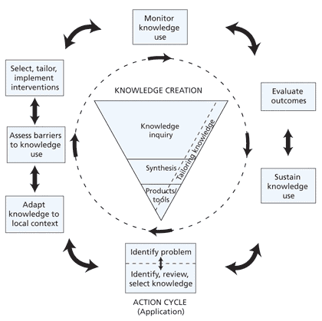
Knowledge to action process
Straus, Tetroe & Graham, 2013
Graham et al., 2006
Notes:
Process Model are designed to illustrate the process of moving research into practice. An example is the Knowledge-to-action Process. Initially developed by Graham, which described a single direction process, the model was updated by Straus and colleagues in 2013 to illustrate an iterative process. In fact, in the recent publication the authors encourage people to view this as a fluid process in which that every step could take place before or after the other steps when it is applied in real life.
At the core of the model is the ‘Knowledge Funnel’. As the knowledge moves through the funnel, it becomes more distilled and refined, and presumably more useful to stakeholders. These include the 2nd generation of knowledge, such as systematic reviews and the 3rd generation of knowledge, such as practice guidelines and quality indicators.
In order for these knowledge product to be used to inform practice, it needs to move into the Action Cycle, which involves an iterative process of identifying the problem between what is known and what is currently done in practice, adapt the knowledge to the need of the users, assess the barriers to use the knowledge, select and tailor the implementation intervention. Once the implementation process is in place, there needs to a plan to monitor the knowledge use, for example, if there is a change in practice behavior; the impact on patient outcome, and the sustainability of the use. Throughout this process, new issues may be identified that may require further adaptation of the knowledge, tailoring of the implementation process, and further evaluation.

Slide 15
Keys steps in implementation science research
preimplementation planning: gather stakeholders and make the case for evidence translation
designing the implementation strategy: use behavioral theory/ frameworks to identify barriers and facilitators to implementation and guide development of implementation strategies
evaluating the implementation strategy: employ rigorous evaluation designs to determine whether strategies to bridge the gap are effective and why or why not
Notes:
Steps for conducting implementation science and preintervention planning research
Preintervention planning steps
Describe the evidence to be translated and its relation to a health problem. Steps 1 and 2 can occur concurrently.
What evidence (health-related behavior, test, procedure, treatment, intervention, program) will be translated?
Justify the evidence is ready to be translated (including in the local context).
What health problem will translation of the evidence improve? Justify selection of this health problem as a priority in the setting you plan to work.
Identify stakeholder communities and conduct outreach to work with them (if not completed in step 1).
List key communities/stakeholders involved in translating your evidence
Consider vested interests of key communities/stakeholders
Describe plan for engaging communities/stakeholders
Describe the evidence-practice gap
Performance gap: What is the difference between current and ideal practice and behaviors? What are the underlying conditions and context?
Outcome gap: How much improvement in health outcomes (safety, effectiveness, efficiency, patient-centeredness, timeliness and/or eliminating disparities in care) could be achieved if the performance gap was eliminated?
Could unintended consequences result from attempts to change practices or conditions contributing to performance gap?
Determine the population, organization and/or stakeholder readiness for change
Strategic: Is addressing the problem area part of strategic priorities?
Structural: Are there local programs or resources that will facilitate implementation and sustain the improvement activity after the project team is done?
Intervention design steps
Describe evidence–practice gap in behavioral terms (Who needs to do what differently?)
Select behaviors upon which to frame the implementation strategy
Identify barriers and enablers of selected behaviors using a theoretical framework
Select evidence-based strategies for behavior change (using the chosen theory or framework)
Implementation strategy evaluation steps
Identify and measure mediators of change Note: may repeat some steps above or look at institutional/community behaviour change theories and frameworks.
Select process, implementation and health outcomes
3. Select appropriate and feasible study designs

Slide 16
Notes:
The amount of data we produce every day is mind-boggling. There are 2.5 quintillion bytes of data created each day at our current pace, but that pace is only accelerating with the growth of the Internet of Things (IoT).
Over the last two years alone 90 percent of the data in the world was generated. REPEAT.

Slide 17
Generating data through
Clinical trials
Primary data
Medical records (EHR)
Claims
Registries
Person Generated Health Data PGHD
Wearables
Hearables?
Social media
Other

Slide 18
Health care data
Healthcare data: compound annual growth rate (CAGR) of 36% through 2025
versus data CAGR in:
manufacturing industry 30%
financial services 26%
media and entertainment 25%

Slide 19

Person Generated Health Data (PGHD)
Supplement existing clinical data, filling in gaps in information and providing a more comprehensive picture of ongoing patient health
Health-related data created, recorded, or gathered by or from patients (or family members or other caregivers) to help address a health concern.
PGHD are distinct from data generated in clinical settings and through encounters with providers
Notes:
Health-related data created, recorded, or gathered by or from patients (or family members or other caregivers) to help address a health concern.
Including but are not limited to:
health history
treatment history
biometric data
symptoms
lifestyle choices
PGHD are distinct from data generated in clinical settings and through encounters with providers in two important ways:
Persons, not providers, are primarily responsible for capturing or recording these data.
Persons decide how to share or distribute these data to health care providers and others.
Examples include blood glucose monitoring or blood pressure readings using home health equipment, or exercise and diet tracking using a mobile app or wearable device.

Slide 20
The value of data science in addressing SDoH
Applying the SDoH framework enables the capture of data held in unstructured text and diagnosis codes.
2 million SDoH -related diagnoses
Data lake of over 40 M records.
Top diagnoses:
disruption of family
separation or divorce disappearance or death of a family member
unemployment
Better insight into patients’ background
Better tailor healthcare services
Build on these insights with artificial intelligence and machine learning
Better outcomes
Gather important information about how patients are doing between medical visits.
Provide information for use in shared decision-making about preventive and chronic care management.
Offer potential cost savings and improvements in quality, care coordination, and patient safety.
Notes:
To succeed with value-based payments, healthcare organizations are paying more attention to SDoH in their own data. But it requires consistent data collection, comprehensive data sources and data analytics. This is the only way to capture rich data and effect meaningful change.

Slide 21
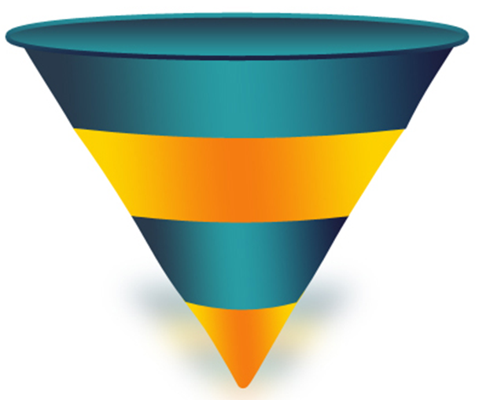
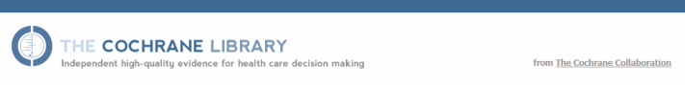

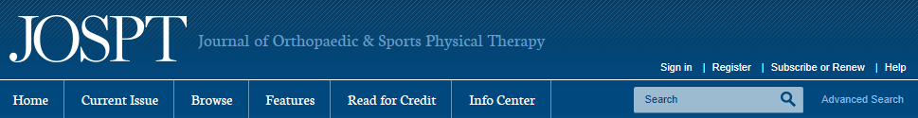
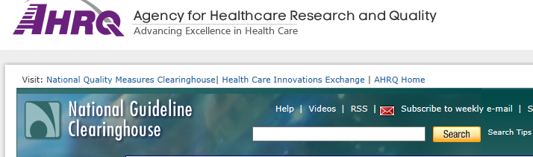
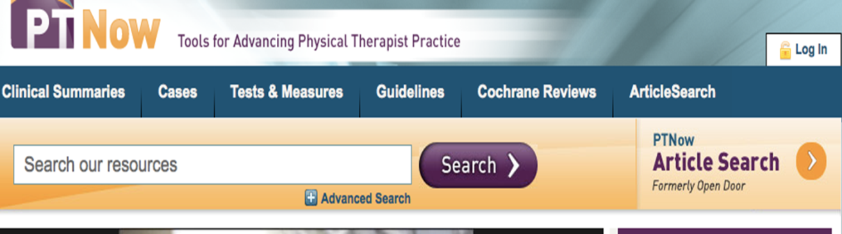
Synthesis documents
Clinical Practice Guidelines, Cochrane Reviews - Primary literature consumption is not feasible on a large scale for impacting clinical behaviors
An internist must read 34 primary literature articles daily to stay current
Notes:
Statements that include recommendations intended to optimize patient care that are informed by systematic review of evidence and assessment of benefits and harms of alternative care options

Slide 22
Quality indicators in chronic diseases
Disease / condition | Pass rate: Managed care | Pass rate: Primary care
Stroke | 82% | 65%
Hypertension | 77% | 72%
Heart failure | 71% | --
Diabetes | -- | 74%
Depression | 31% | --
Osteoarthritis | 31% | 29%
Li (2011) | -- | 22% (non-pharmacological)
Grønhaug (2014) | -- | 47%
Doubova (2015) |  | 20-26% (non-pharmacological)
QI are evidence based tools that provide a pass rate to show the % of people who received the care out of those who needed it
Askari et al., PLoS One, 2011
Notes:
In the last 50 years, health research has come a long way in improving survival, reducing severe disability and improving quality of life.
BUT it is not hard to find examples where research is not being used in practice.
One way to provide an objective measure of the performance in health care is to use quality indicators. These are evidence-based tools that provide a ‘pass rate’ that indicates the percentage of people received the necessary treatment or service out of the total who needed the care. Around the late 90’s/early 2000, a number of quality indicators were developed. A recent systematic review examined the quality of care in chronic diseases in older adults found that, compared to a variety of chronic diseases, the pass rate for OA care was consistently low across managed care and primary care setting.

Slide 25
The ‘K’ on OA management
Year | Country | Guideline organization
2003 | Europe | EULAR-knee
2005 | Europe U.K. | EULAR-hip MOVE Consensus Group
2007 | Europe | EULAR-hand
2008 | U.S. International France U.S. | National Collaborating Centre for Chronic Conditions OA Research Society International (OARSI) French Clinical Practice Guideline Group American College of Clinical Pharmacy
2009 | U.S. | American Physical Therapy Association
2011 | Netherlands U.S. | The Dutch OA Guideline Group Michigan Quality Improvement Consortium
2012 | U.S. Asia Canada | American College of Rheumatology Chronic Pain Advisory Board The Ottawa Panel
2013 | U.S. | American Academy of of Orthopaedic Surgeons
Adapted from: Nelson et al., Semin Arthritis Rheum, 2014
Notes:
This is particularly alarming because the knowledge on OA management, has been quite consistent over the years. A team in Chapel Hill has recently reviewed the 15 guidelines and recommendations in OA management.
What they found was that the recommendations on the first-line pharmacological and non-pharmacological management were in remarkable agreement across organizations and countries.
This is just 1 example that demonstrates why we need to invest in knowledge translation and implementation research.

Slide 26
Example: inhaled corticosteroids in the ED

Slide 27
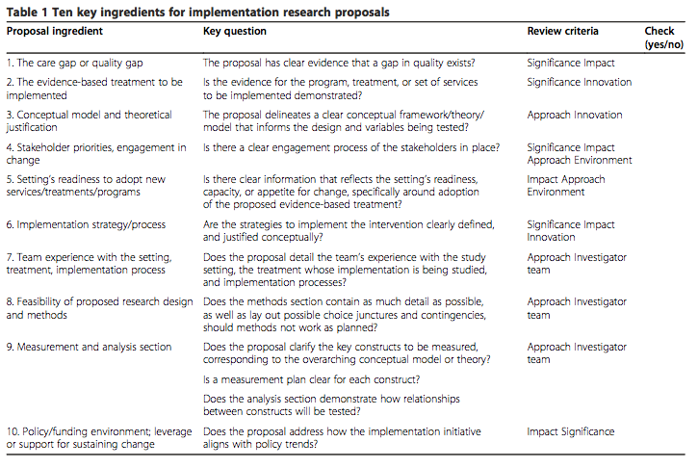
Ten ingredients for implementation research proposals
Proctor EK, et al. Implementation Science 2012;7:96

Slide 28
Examples databases for investigating care delivery, costs, insurance, provider characteristics, and delivery system contexts
Medical Expenditure Panel Survey, the most complete source of data on the cost and use of health care and health insurance coverage
Compendium of US Health Systems, 626 U.S. health systems, with characteristics for each system.
Healthcare Cost and Utilization Project,: includes health care data on hospital inpatient discharges, ambulatory surgery and other outpatient services, and emergency department visits

Slide 29
Examples of funded implementation research
Expanding an innovative treatment model for infants with NAS: Using the consolidated framework for implementation research to identify facilitators and barriers to implementation
Implementation strategies to ensure consistent delivery of a pharmacy service within an at-home patient population
The implementation determinants of telerehabilitation for stroke survivors: A rapid realist review
Social networks to help diabetes control

Slide 30

Plans
Innovation and Implementation Science Interest Group
Infrastructure project
Prepare researchers to develop effective interventions in “real-world” settings
Build an ecosystem of agile implementation
Fadia T. Shaya, PhD, MPH
Professor and Executive Director
Behavioral Health Resources and Technical Assistance Program
Professor and co-Director Informatics
Institute for Clinical and Translational Research
fshaya@rx.umaryland.edu
410-706-5392

Slide 31
In theory, there is no difference between theory and practice, but in practice there is*
*Yogi Berra

